Slide 1
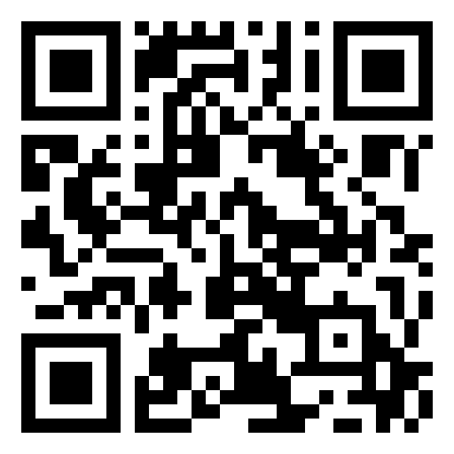
Scan to RSVP

Slide 3

Notes:
Features:
- automatic advance slide

Slide 4
Notes:
Features:
Animation delay
Animation easing

Slide 5
Please wait

Slide 7
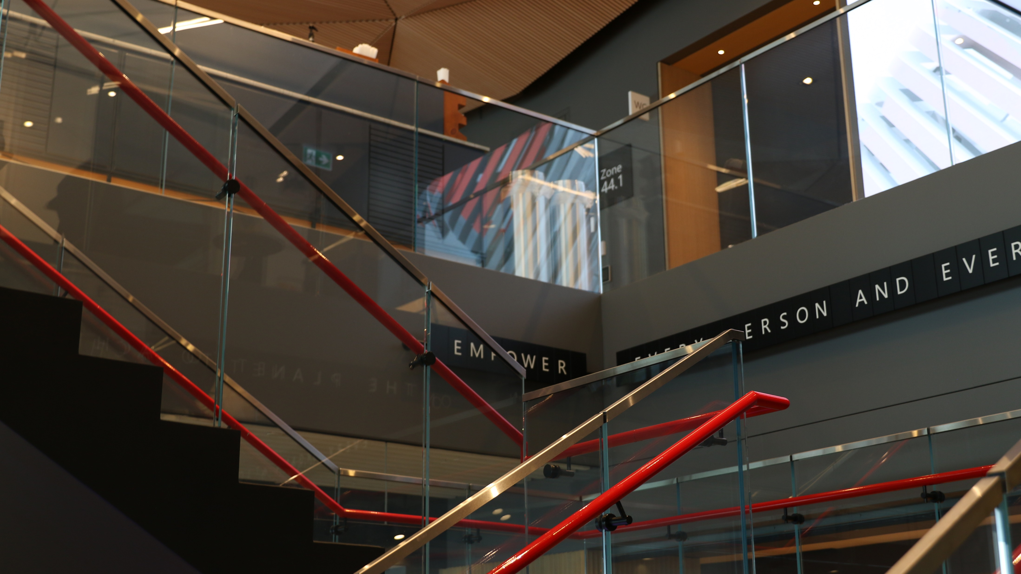
Notes:
Features:
- Live updating clock object

Slide 8


jack
Sign in
Notes:
Features:
Morph
Hover actions

Slide 9
jack
Sign in
Notes:
Features:
Hover actions
onClick actions

Slide 10
jack
Welcome

Slide 11




Microsoft 365
Starting Microsoft PowerPoint…
Type here to search
4:56 PM
4/5/2024

Slide 12

POWERPOINT
April 5th, 2024

Slide 13




AGENDA
Templating
Shapes
Slide master, color palette, slide size, global font, embedding fonts, saving as ppt template
Freeform shape tool, masks, pathfinder, shape fill (images, gradient), importing/exporting SVGs
Multimedia
Interactivity
Remove image background, videos as backdrop, record voice, placing blurred images on shapes
Action menu, hyperlinks, animation triggers, morph animation, 3d models, BrightSlide

Slide 14
demo

Slide 15
End of slide show, click to exit.

